Slide 1
Rubik’s Cube+: A self-supervised feature learning framework for 3D medical image analysis Jiuwen Zhu, Institute of Computing Technology, Chinese Academy of Sciences Yuexiang Li, Tencent Jarvis Lab Yifan Hu, Institute of Computing Technology, Chinese Academy of Sciences June 2020, Medical Image Analysis

Slide 2
Background
Supervised Learning: Large amount of labeled data.
Unsupervised Learning: Clustering with unlabeled data.
Semi-supervised Learning : Small amount of labeled data.
Self-supervised Learning : Unsupervised Learning. Using pretext to help learn semantic image features to initialize the subsequent task.

Slide 3
Introduction
Jigsaw puzzles: re-assemble the separated and mixed tiles.
Rubik’s cube: cube ordering and cube orientation(previous work).
Rubik’s cube+: Rubik’s cube + masking identification.
3D data: Recover Rubik’s cube.
Main purpose: Leverage more spatial info & yield more robust feature.

Slide 4
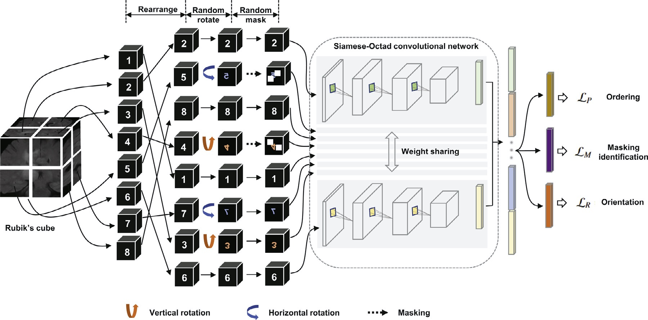
Method
Notes:
RP Shortcomings：1.relative position has multi result. 2.CNN learn trivial features. 3. not whole picture.

Slide 5
Method
Notes:
RP Shortcomings：1.relative position has multi result. 2.CNN learn trivial features. 3. not whole picture.

Slide 6
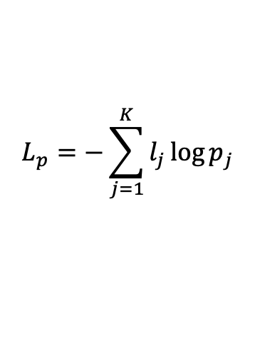

Method
Data Preprocess: Gap between 2 adjacent cubes. Normalized to [-1,1].
Cube Ordering: Rearrange to 2×2×2. The permutation of it is :
$$P=(P_{1},P_{2},…,P_{8!})$$
Select $K$ permutaions with Hamming distance from $P.$
Loss: cube ordering is seen as a classification task with $K$ categories.
$$L_{p}=−\sum_{j=1}^{K}{l_{j}\log{p_{j}}}$$
Where $l_{j}$ represents one-hot ground-truth and $p_{j}$ represents predictions.
Notes:
RP Shortcomings：1.relative position has multi result. 2.CNN learn trivial features. 3. not whole picture.

Slide 7
Method
Notes:
RP Shortcomings：1.relative position has multi result. 2.CNN learn trivial features. 3. not whole picture.

Slide 8
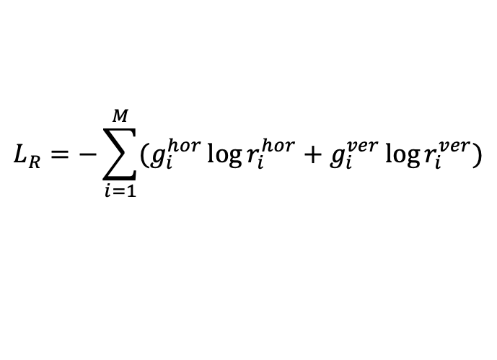
Method
Cube Orientation: Only allowing $180°$ horizontal and vertical rotation.
GT:$1×M$ with 1 on position of rotation and 0 vice versa.
Output: two $1×M$ indicate possibility of hor and ver.
Loss: Seen as a multi-label classification
$$L_{R}=−\sum_{i=1}^{M}{(g_{i}^{hor}\log{r_{i}^{hor}}+g_{i}^{ver}\log{r_{i}^{ver}})}$$
Notes:
RP Shortcomings：1.relative position has multi result. 2.CNN learn trivial features. 3. not whole picture.

Slide 9
Method
Notes:
RP Shortcomings：1.relative position has multi result. 2.CNN learn trivial features. 3. not whole picture.

Slide 10
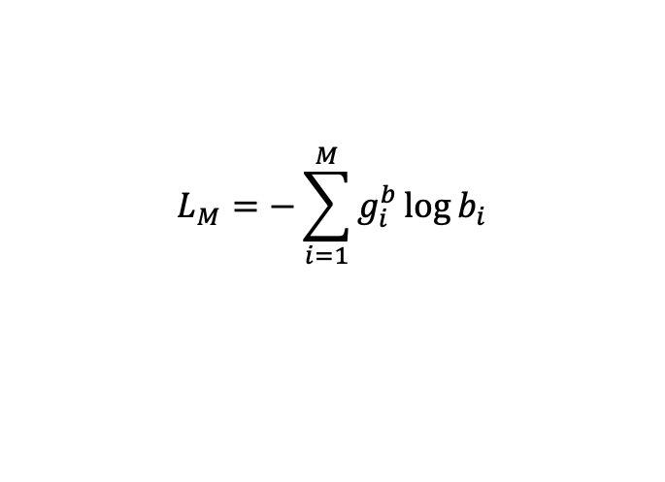
Method
Masking Identification: In pixel wise.
$C^{m}(x,y,z)=$ $C^{0}\left(x,y,z\right) ∙R(x,y,z)$
Loss: Seen as a classification task.
$$L_{M}=−\sum_{i=1}^{M}{g_{i}^{b}\log{b_{i}}}$$
Notes:
RP Shortcomings：1.relative position has multi result. 2.CNN learn trivial features. 3. not whole picture.

Slide 11
Method
Notes:
RP Shortcomings：1.relative position has multi result. 2.CNN learn trivial features. 3. not whole picture.

Slide 12

Method
Siamese-Octad: 8 Siamese network.
3 fully connection layers.
Siamese Net: 3dVGG or 3dResNet with classification.
3dUnet with segmentation.
$Loss= L_{P}$ + $L_{M}+L_{R}$

Slide 13
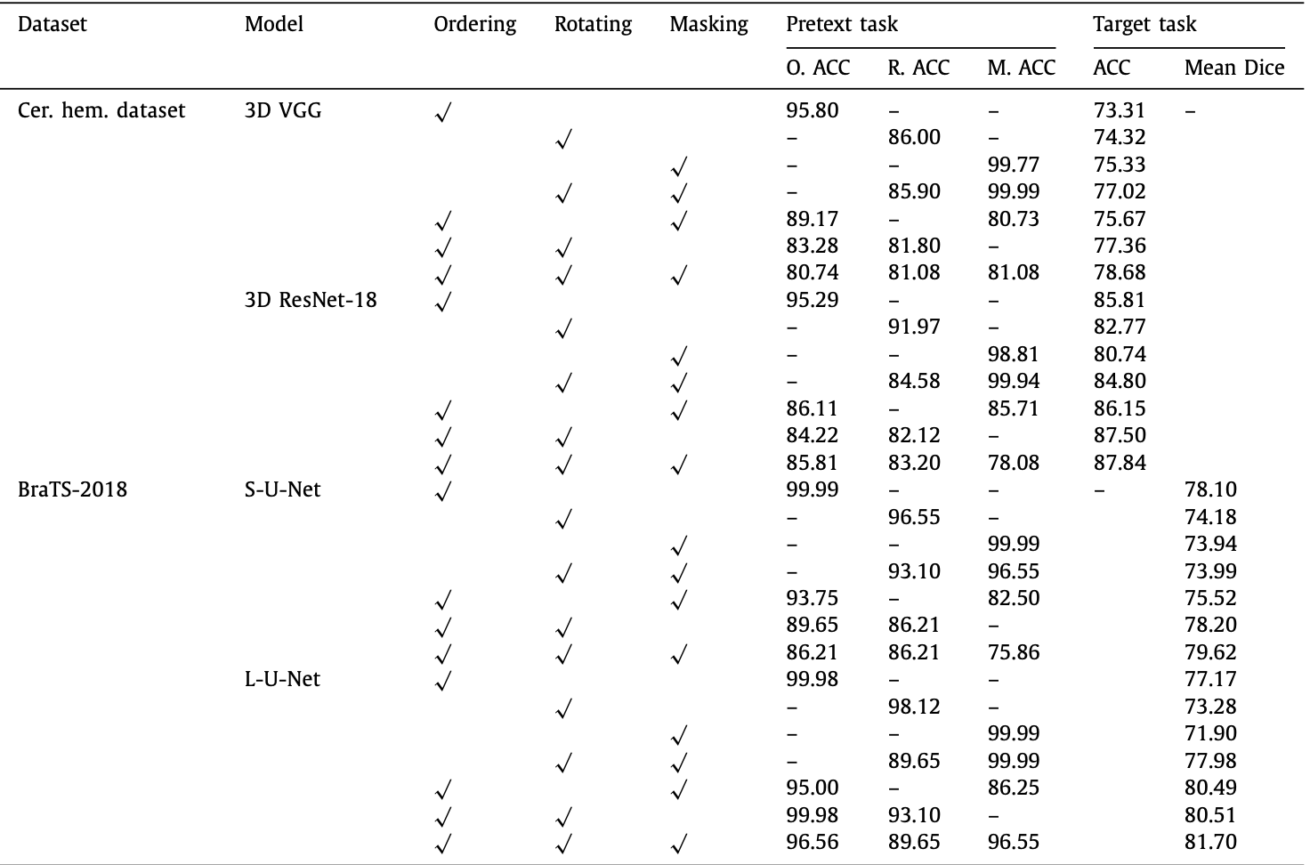
Experiment

Slide 14
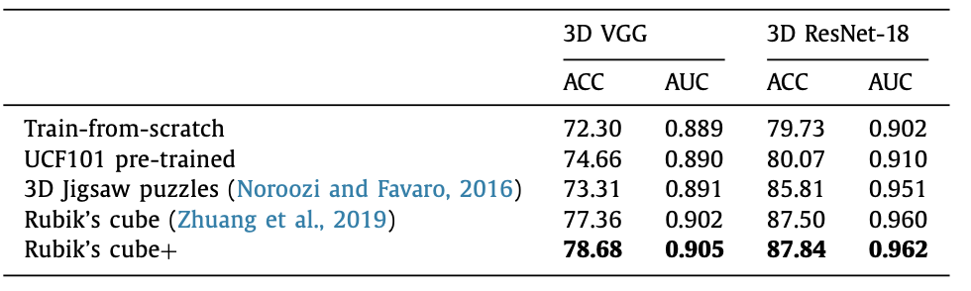
Classification
6.38% and 8.11% higher than t-f-c.
More diverse on pretext can learn more robust features.

Slide 15
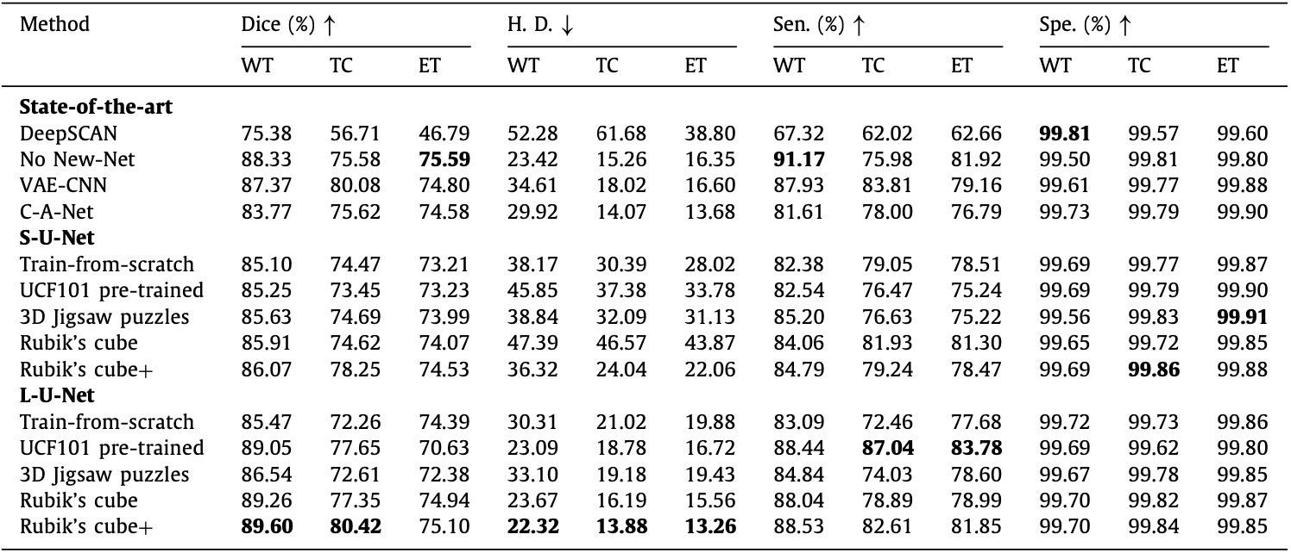
Segmentation
L-U-Net aims to maintain the relatively high values for both spe and sen.

Slide 16
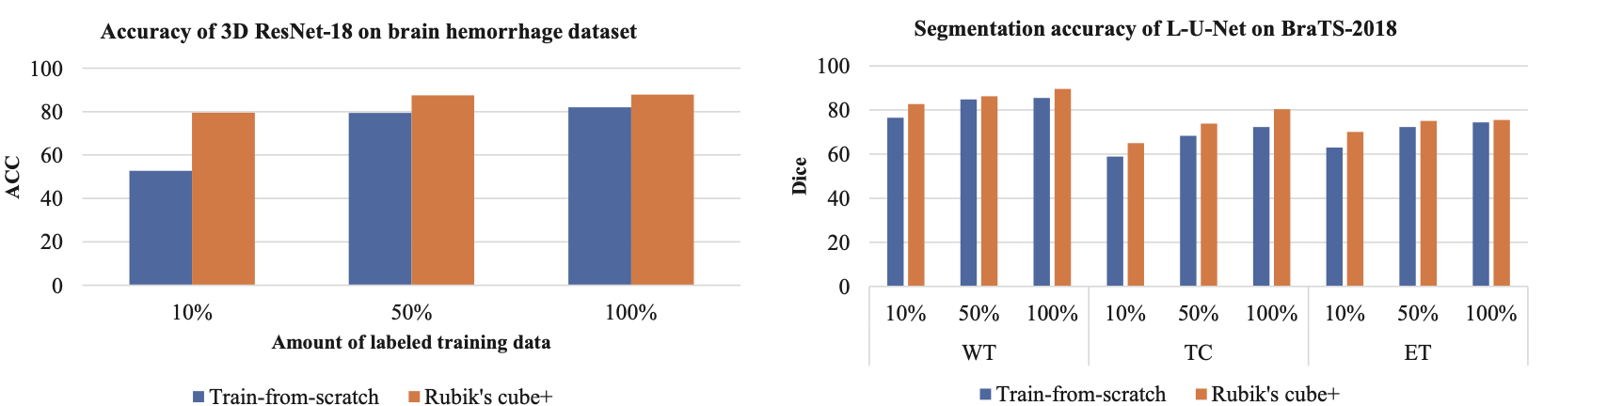
Data Amount
Few labeled data can still improve the performance with cube+ pretext task.

Slide 17
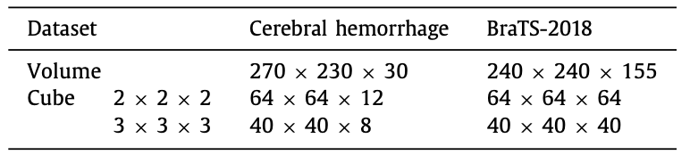
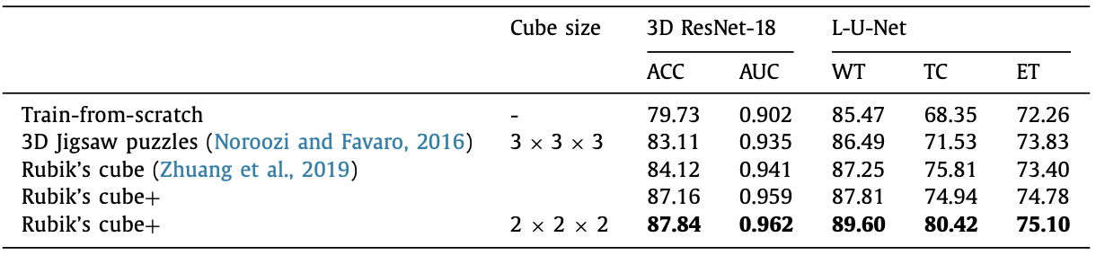
Order of Cube
Higher order may destroyed the spatial information.

Slide 18
Conclusion
Contribution:
Three pretext task: order, orientation, mask.
On 3D: yield more spatial information.
Shortcomings:
Focus more on global feature.
Mask identification task is simple.

Slide 19
Thank you (Q&A)
Notes:
RP Shortcomings：1.relative position has multi result. 2.CNN learn trivial features. 3. not whole picture.

